Slide 1
Project Management Methodology
Project Integration Management

Slide 2
Integration Management Processes
Developing the project charter
Developing the project management plan
Directing and managing the project executing
Monitoring and controlling project work
Performing integrated change control
Closing the project or phase

Slide 3
Project Charter
This is a major project management document written by the Project Manager
Should be signed off by key project stakeholders to acknowledge agreement on the need of the project
Is a key output of the project initiating stage

Slide 4
Project charter content
The project title
The project manager’s name
A summary schedule, including planned start and end dates
A summary of the project budget
A brief description of the project objectives, including the business needs and other justifications of the project

Slide 5
Project charter content
A summary of the planned approach for managing the project, including information about stakeholders, important assumptions and constraints
A role and responsibility matrix (RACI)
Known project risks
A sign-off section for signatures of key project stakeholders

Slide 6
Project management plan
A document used to coordinate all project planning documents and guide project executing and control
Planning documents created to manage other project activities are considered as subsidiary parts of the overall project management plan
This is the essence of the project integration process

Slide 7
Project management plan content
Depends on the size of the project
Small project:
  Project charter
  Scope statement
  MS project schedule
Large project:
  Each knowledge area is addressed
  Other major processes included
Keep the balance between the project size and amount of project management documentation

Slide 8
Project management plan content
Project organization
  Organizational chart
  Project responsibilities
Management processes
  Project controls
  Quality control
  Risk management
  Communication management
  Project staffing

Slide 9
Project management plan content
Scope management key definitions
  Work packages
  Key deliverables
Time management key definitions
  Project schedule
  Key deliverables and milestones
Cost management
  Budget information

Slide 10
Directing and managing project execution
Project execution constitutes a major part of the project time and budget
Project manager implements in practice project management plan and its parts
Focus on leading project team and manage stakeholders expectations

Slide 11
Directing and managing project execution
Coordinating planning and execution
  Those who will do the work should plan the work
Provide strong leadership and support to the team
Capitalizing on product, business, and application area knowledge
  Project manager is expected to understand these areas

Slide 12
Monitoring and controlling project work
Collecting, measuring, and disseminating performance information
Tool is important, like MS Project
The baseline should be created to control and identify deviations
Performance reports will be created
Change request may be created to address deviations

Slide 13
Performing integrated change control
That is identifying, evaluating, and managing changes through the project life cycle
Change request must be formally created, reviewed by stakeholders, and approved
A change control board is a formal group that approve change request
Formal documented change control process must exist

Slide 14
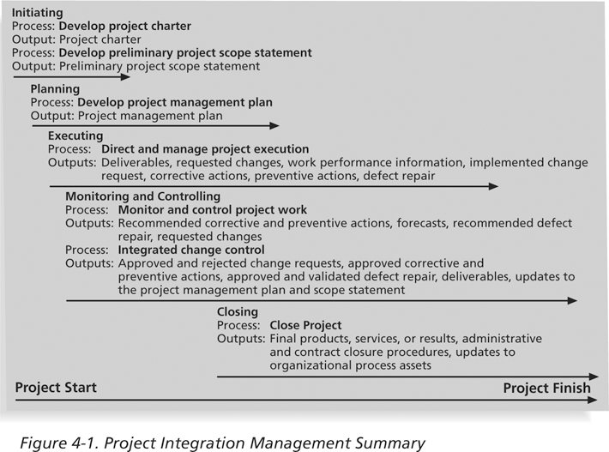
Figure 4-1: Project Integration Management Summary
Information Technology Project Management, Fifth Edition, Copyright 2007

Slide 15
Using Software to Assist in Project Integration Management
Several types of software can be used to assist in project integration management
  Documents can be created with word-processing software
  Presentations are created with presentation software
  Tracking can be done with MS Project
  Communication software like e-mail and Web authoring tools facilitate communications
  Project management software can pull everything together and show detailed and summarized information
  Business Service Management (BSM) tools track the execution of business process flows
Information Technology Project Management, Fifth Edition, Copyright 2007

Slide 16
Project scope management
Scope refers to all the work involved in creating the products and all related processes
Project scope may be described by the project deliverables, that relate to the product or processes
Project scope must be described from both “in scope” and “out of scope” positions

Slide 17
Project scope management
Project scope managing processes:
  Collecting requirements
    Functional and non-functional
  Defining scope in the Project Charter
    Write appropriate section
  Creating the WBS
    Use MS Project
  Verifying scope
    Obtain acceptance from stakeholders
  Controlling scope
    Control changes by change requests

Slide 18
Collect and document requirements
Methods
  Interview stakeholders
  Develop prototypes
  Create requirements traceability matrix

Slide 19
Collect and document requirements
Create comprehensive list of requirements for each category:
  User
  Business
  Functional
  Technical

Slide 20
Creating the Work Breakdown Structure (WBS)
Project deliverable – an interim but tangible result achieved at some point time thru the project development. Can be used to evaluate the project state
A WBS is a deliverable-oriented grouping of the work involved in a project that defines the total scope of the project
Information Technology Project Management, Fifth Edition, Copyright 2007

Slide 21
Practical approaches to create WBS - by SDLC stages
Top-down: by SDLC stages
  Project definition
  Requirements development
  Solution Design
  Solution Implementation
  Testing
  Move to production
Complimentary activities
  Vendor selecting
  Training

Slide 22
Practical approaches to create WBS - by SDLC stages (cont)
How to:
  For each stage consider the tasks and activities required to complete the tasks
  Decompose from more generic to more detailed
  Use verbs, not nouns to articulate the tasks
  First, create a flat list and then do grouping

Slide 23
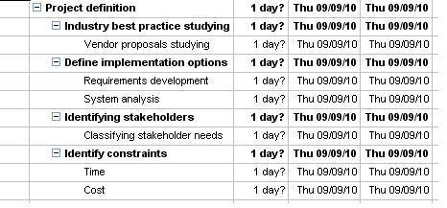
Practical approaches to create WBS - by SDLC stages (cont)
Example

Slide 24
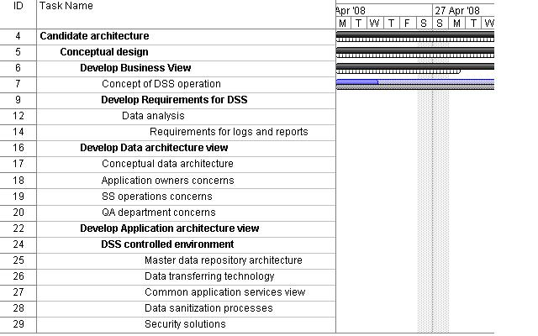
Practical approaches to create WBS - by SDLC stages (cont)

Slide 25
Other things to do with WBS
Identify dependencies between the tasks
Identify milestones
  Critical deliverables
Assign the owner for each task
  One who is accountable
Identify tasks details (more information later)
  Resources required (skilled professionals, time estimate, money)
  Supplies (equipment, software)
  Completion criteria

